Slide 1
Computer Vision Fundamentals
Lecture 3 - Part 4
Point thresholding

Slide 2
Contents
Thresholding
Single Thresholding
Double Thresholding
Applications of Thresholding

Slide 3
Thresholding
Thresholding is a vital part of image segmentation, where we wish to isolate objects from the background. It is also an important component of robot vision.

Slide 4
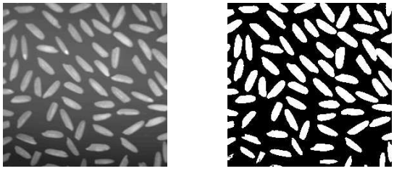
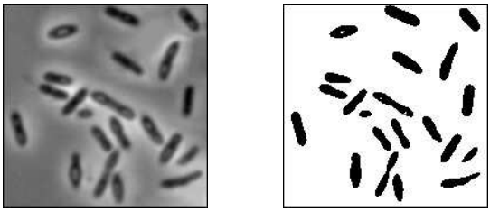
Single Thresholding
>> r=imread(’rice.tif’);
>> imshow(r),figure,imshow(r>10)
>> r=imread(’rice.tif’);
>> imshow(r),figure,imshow(r>10)

Slide 5
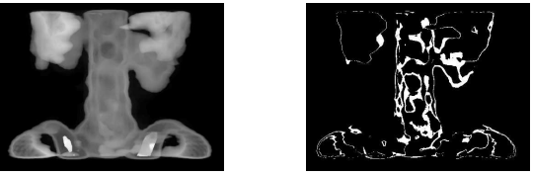
Double Thresholding
>> [x,map]=imread(’spine.tif’);
>> s=uint8(256*ind2gray(x,map));
>> imshow(s),figure,imshow(s>115 & s<125)

Slide 6
Applications of thresholding
When we want to remove unnecessary detail from an image, to concentrate on essentials. Examples of this were given in the rice and bacteria images: by removing all grey level information, the rice and bacteria were reduced to binary blobs. But this information may be all we need to investigate sizes, shapes, or numbers of blobs.
To bring out hidden detail. This was illustrated with paper and spine images. In both, the detail was obscured because of the similarity of the grey levels involved.
When we want to remove a varying background from text or a drawing. We can simulate a varying background by taking the image text.tif and placing it on a random background.

Slide 7
Thankyou

